Slide 1




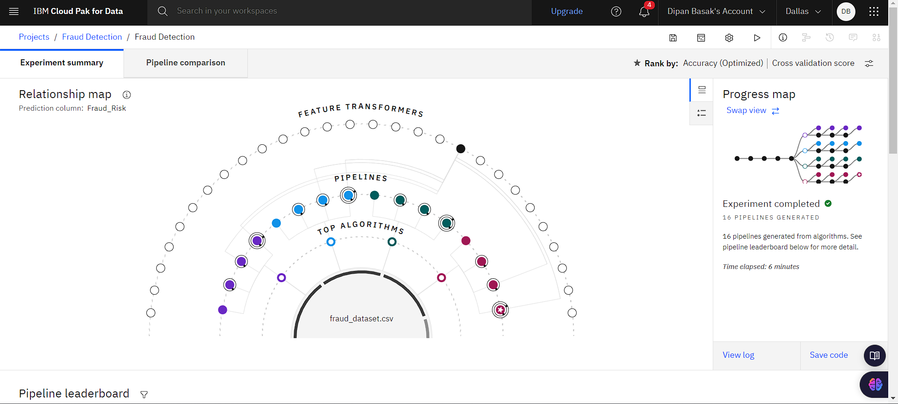
Fraud Detection Model
Program Feedback
Project Short Summary
Hey Thanks for this opportunity, I learnt a lot, now I have developed my interest in Data Science and would like to pursue my career in this field, it gave me clarity, I would like to thank Edunet for providing resources to start my career and have a good path. Thank You once again Uzma Ma'am !!
Fraudulent transactions are a significant financial risk. This project uses IBM’s Auto AI in Watson Studio to automate and streamline fraud detection. By leveraging cloud storage and Python, the system efficiently processes transaction data, builds and deploys accurate predictive models. The automated approach reduces development time and improves detection accuracy, offering a scalable solution adaptable for other predictive tasks.
Dipan Basak
dipaneducation46@gmail.com
Institute of Engineering and Management
Kolkata
#skillsbuild
Notes:
Dipan Basak

